Slide 1
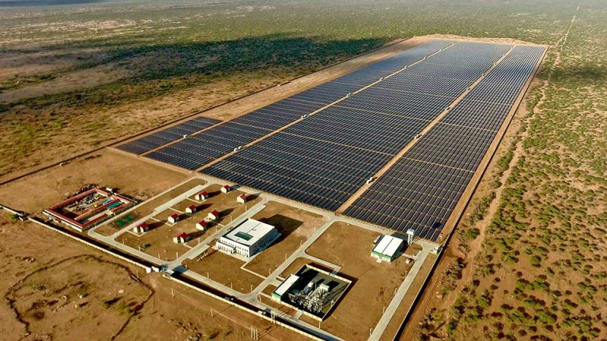
HORIZON EUROPE ALIGNMENT
HORIZON-CL5-2027-02-D3-10
SHEPA Project
Progress Report
Merti Site Assessment & System Design Framework
Presntation by:
Cassandra Lelei
Joy Chemutai
Joey Kanyi
Solar-Battery-Hydrogen Hybrid Microgrid for Rural Electrification
March 2026
Merti, Isiolo County, Kenya
Technical Consortium Review

Slide 2
SECTION 01
What is a Solar Microgrid?
From basic electrification to resilient, zero-carbon energy systems
SHS
Minigrid
Hybrid
Diesel Hybrid
SHEPA
Solar Home Systems
Community Minigrids
Solar-Battery Hybrid
Solar-Battery-Diesel
Solar-Battery-H₂ Hybrid
Individual household units with small PV panels and basic battery storage for lighting and phone charging
Standalone systems serving multiple households with centralized generation and distribution network
Integrated PV generation with lithium-ion battery storage for 24/7 power and load balancing
Hybrid systems with diesel backup for extended cloudy periods, reducing but not eliminating fossil fuel dependence
Zero-carbon resilience: Seasonal hydrogen storage enables 100% renewable operation with multi-day backup capability
Capacity: 10-100W
Capacity: 10-100kW
Capacity: 50kW-1MW
Capacity: 100kW-5MW
Capacity: 100kW-10MW+
SHEPA Innovation: Third-Life Batteries
SHEPA introduces a circular economy dimension by using third-life batteries — batteries that have completed their first life in EVs (capacity ~80%) and second life in stationary storage (capacity ~60-70%), then reconditioned for microgrid deployment at ~50-60% original capacity. This dramatically reduces upfront costs while addressing Kenya's e-waste challenge.

Slide 3
SECTION 02
Merti: Energy-Poor, Resource-Rich
Isiolo County, Northern Kenya — A paradox of abundant renewable resources and severe energy poverty
Location & Climate
Abundant Resources
Arid & Semi-Arid Lands (ASAL)
Solar Irradiance
6.16
Northern Kenya, Isiolo County
kWh/m²/day — Excellent resource
Source: NASA POWER 39-46yr dataset
Extreme Temperatures
Wind Resource
6.95
Regularly 35°C+ ambient
m/s at 100m — Strong potential
Source: Global Wind Atlas
Severe Dust Events
January-March, up to 60% solar loss
Relative Humidity
57%
Mean annual — Borderline for AWG
Seasonal variation unknown
Demographics
~10,990
~57,826
The Energy Poverty Paradox
Urban Population
Sub-County Total
Despite exceptional renewable resources, Isiolo County has only 22.7% electricity access (KNBS 2015). 85% of households rely on firewood for cooking. SHEPA aims to transform this resource abundance into energy access.
Source: KNBS 2019 Census, Isiolo CIDP 2023-2027

Slide 4
SECTION 04
Mweiga vs. Merti: Same Architecture, Different Contexts
How site-specific data drives divergent designs despite identical system concepts
Comparative Parameters
Parameter | Mweiga (Known) | Merti (Estimated/Partial)
Solar Irradiance | 5.5 kWh/m²/day | 6.16 kWh/m²/day (+12%)
Population Served | ~100 people | ~10,990 urban / ~57,826 sub-county
Ambient Temperature | ~20-25°C (highland) | 35°C regularly (10-15% thermal derating)
Dust/Soiling | Minimal | Severe Jan-Mar (up to 60% loss on event days)
Wind Resource | Low | Strong: 6.95 m/s M100 annual mean
Load Inventory | Verified from community engagement | Not yet confirmed
Water Source | Shared borehole | Unknown — boreholes exist but unquantified
RH for AWG | Moderate (highland) | 57% mean — seasonal variation unknown
Land Available | Confirmed | Not yet confirmed
Mweiga Success Factor
Merti Design Dependency
The Mweiga design worked because data was thorough and verified through direct community engagement. Load profiles, water sources, and land availability were all confirmed before sizing.
Merti's design depends on collecting the same quality of data. Without confirmed load inventory, accurate sizing is impossible. The community questionnaire is designed to fill these gaps.

Slide 5
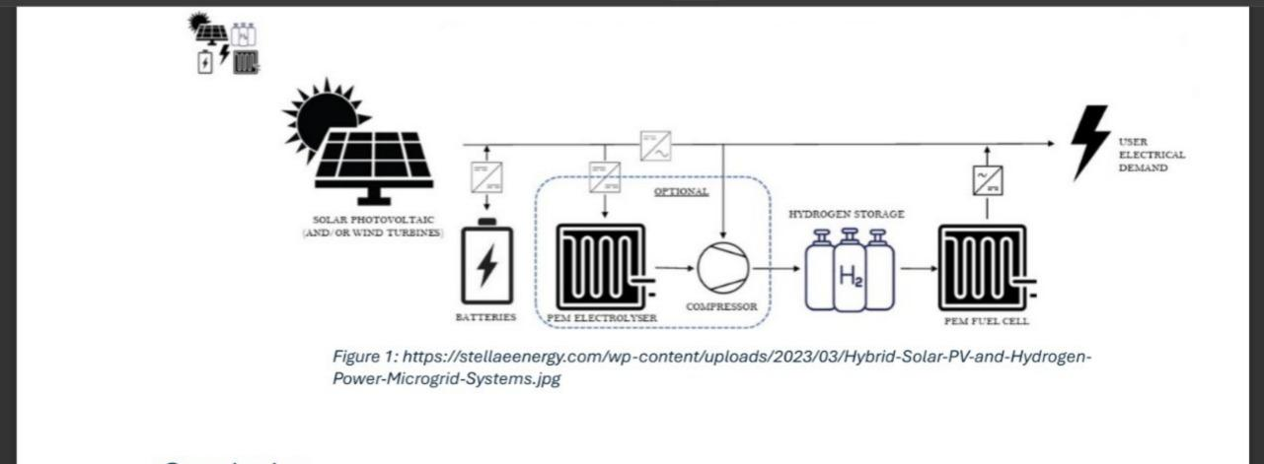
SECTION 03
SHEPA System Architecture
Integrated Solar-Battery-Hydrogen hybrid microgrid with multi-vector outputs
System Flow Diagram
Solar PV Array
Primary generation: 165-170kW (310×550W panels). Captures 6.16 kWh/m²/day in Merti.
Battery Storage
Short-term buffer: ~2.2 MWh third-life Li-ion. Daily cycling, 70% DoD, ~90% round-trip efficiency.
PEM Electrolyzer
Hydrogen production: 300-350kW PEM. Converts excess solar to H₂ during peak generation periods.
H₂ Storage
Long-term storage: 300kg H₂ (6×50kg tanks at 350 bar). Seasonal backup for dust season deficits.
PEM Fuel Cell
Power regeneration: 60-70kW PEM. Converts stored H₂ back to electricity during extended cloudy periods.
AWG System
Source: Stella Energy Hybrid Solar-Hydrogen Microgrid Systems
Water generation: 2,500-3,000 L/day. Atmospheric water generation from ambient humidity.
Zero-carbon resilience: SHEPA enables 24/7 power, water, and supports food production through cold chain & irrigation — all without fossil fuel backup.

Slide 6
SECTION 03 — INNOVATION FOCUS
Third-Life Batteries: The Circular Innovation
From EV mobility to community energy — extending battery value through three lifecycles
The Three-Life Journey
Why Third-Life for SHEPA/Merti?
1
First Life: EV Mobility
Dramatically Lower Upfront Cost
Battery serves in electric vehicle until capacity drops to ~80% of original — retired from vehicle use due to range requirements.
Up to 28% cost savings vs new batteries (CrossBoundary Innovation Lab data)
Circular Economy Alignment
Extends battery lifecycle, reduces raw material demand
Reduces E-Waste in Kenya
2
Second Life: Stationary Storage
Addresses growing battery waste challenge from EV adoption
Repurposed for grid/storage applications until capacity drops to ~60-70% — retired from grid storage due to performance requirements.
Scale-Appropriate Performance
Lower energy density acceptable for community microgrid applications
3
Third Life: Community Microgrid
Local Partnership Ecosystem
Reconditioned and repurposed for microgrid application at ~50-60% original capacity . Lower energy density acceptable at community scale.
Spiro
East Africa's largest EV motorcycle fleet operator. 80,000+ e-motorcycles deployed, 300,000+ batteries in circulation, 2,500+ swap stations across 6 countries. Generates large stream of retired battery packs in Kenya.
Roam Electric
Design Implications
Nairobi-based EV manufacturer (motorcycles & buses). Actively working on second/third-life battery repurposing. New Roam Park facility with automated assembly lines.
Depth of Discharge (DoD): Conservative 70% (vs 80-90% for new batteries) to account for variable cell capacity. Round-trip efficiency: ~90%.
Notes:
Cost per kWh: $100 – $150/kWh, $30 – $80/kWh and $5 – $30/kWh

Slide 7
SECTION 03 — WEFE NEXUS
Water-Energy-Food-Ecosystem Integration
Mapping SHEPA components to the EU-promoted WEFE framework for integrated resource management
WATER
ENERGY
WEFE Nexus Synergies
The WEFE approach recognizes that water, energy, food, and ecosystems are interconnected systems that must be managed together. SHEPA explicitly addresses all four dimensions:
AWG System
Solar + H₂ System
Atmospheric Water Generation produces 2,500-3,000 L/day of clean water from ambient humidity
Renewable generation with long-term hydrogen storage enables 24/7 zero-carbon power
Energy → Water
Reduces borehole dependency
165-170kW solar PV array
Solar power drives AWG and borehole pumping
Provides potable water for community
300kg H₂ seasonal storage
Supports irrigation needs
60-70kW fuel cell backup
Water → Food
AWG and irrigation enable agricultural production
FOOD
ECOSYSTEM
Energy → Food
Reliable power supports cold chain and processing
Cold Chain + Irrigation
Zero-Carbon Operation
All → Ecosystem
Reliable power enables agricultural productivity through irrigation pumping and cold storage
Environmental benefits through fossil-free operation and oxygen byproduct from electrolysis
Zero-carbon operation preserves environmental integrity
Solar-powered irrigation
100% renewable operation
Cold chain for produce
O₂ byproduct for medical use
EU Horizon Alignment: The WEFE framework is explicitly promoted in HORIZON-CL5-2027-02-D3-10, which prioritizes integrated resource management and circular economy principles.
~1,200m² farm area support
Circular battery lifecycle
Notes:
Hydrogen Process brings the RTE to 40%, areas of improvement are using it for heating, long term storage,

Slide 8
SECTION 04 — DESIGN IMPLICATIONS
What Changes in the Design and Why
Specific parameter shifts driven by Merti's unique context
PV Array Size
H₂ Storage Sizing
Higher GHI Benefit
Critical Design Driver: Dust Season
Merti's 6.16 kWh/m²/day vs Mweiga's 5.5 suggests ~10% smaller array needed for same energy output
January-March dust season is when solar generation drops most severely. H₂ storage must cover this period.
Thermal Derating Impact
Mweiga Reference: 7-Day Backup
35°C+ temperatures cause 10-15% derating — partially cancels GHI advantage
Mweiga design used 300kg H₂ storage for ~7 days backup during cloudy periods
Dust Soiling Loss
Merti Implication: Extended Backup
Jan-Mar dust events cause 5-10% soiling loss (up to 60% on event days)
The 7-day backup may need extending for Merti to cover prolonged dust season deficits
Net Effect:Uncertain without confirmed load figure — gains and losses nearly cancel
AWG Performance
Battery Sizing
Relative Humidity Comparison
Cloudy-Day Risk Profile
Merti's 57% mean RH is borderline for AWG efficiency vs wetter highland Mweiga
Merti's longer dry season and dust events mean different cloudy-day patterns vs highland Mweiga
Critical Unknown: Seasonal Variation
Seasonal RH variation — which we don't yet have — is critical for accurate AWG sizing
Autonomy Requirements
Potentially less battery autonomy needed due to different weather patterns — but this is speculative without load data
Questionnaire Priority: Section G asks about seasonal humidity patterns
Critical Dependency: Load profile determines cycling patterns and storage requirements
Key Insight: Mweiga gave us a design methodology and reference architecture. Merti will give us a real-world proof of how that methodology adapts to an ASAL context. But it only works if the ground data is as thorough as it was in Mweiga.

Slide 9
SECTION 05
What We Already Know About Merti
Confirmed data points that inform the SHEPA design
Solar Resource
Climate Constraints
Third-Life Battery Logistics
6.16
Dust Season
Spiro Presence
kWh/m²/day average
January-March: Severe dust events with up to 60% solar loss on event days
Operates in northern Kenya corridors ; 80,000+ bikes generates retired battery stream
Excellent solar resource
Thermal Derating
Roam Electric
Data Source
35°C+ temperatures cause 10-15% PV derating — major design factor
Nairobi base with expanding reach; actively working on battery repurposing
NASA POWER / SARAH datasets
39-46 year historical record
Design Response
Partnership Status
H₂ storage sized to cover dust season deficits; conservative battery DoD at 70%
Supply chain feasible but needs formal confirmation — a project deliverable
Wind Resource
6.95
Demographics
m/s at 100m height
Strong wind potential
Anchor Loads
Health facilities, schools, trading centers identified as priority loads
Data Source
Global Wind Atlas
Population Growth
Data Confidence: All parameters confirmed through authoritative sources (NASA POWER, Global Wind Atlas, KNBS census, Isiolo CIDP)
Annual mean measurement
2.8% annual growth rate (KNBS 2019)

Slide 10
SECTION 06
Critical Knowledge Gaps
What we don't yet know — and how the questionnaire addresses each gap
Load Demand
Medical Oxygen Opportunity
Gap: Actual Load Inventory
Gap: Health Facility Demand
Not yet confirmed. Critical for accurate sizing of all components.
Electrolyzer produces O₂ as byproduct. Health facility oxygen demand not assessed.
Questionnaire Section
Questionnaire Section
Section C: Load assessment — appliances, usage patterns, peak demand
Section D: Health infrastructure, medical equipment, oxygen needs
Water Infrastructure
Site Availability
Gap: Borehole Data
Gap: Land & Tenure
Boreholes exist but unquantified — water quality, yield, depth unknown
Land availability and tenure for infrastructure not confirmed
Questionnaire Section
Questionnaire Section
Section G: Water sources, quality, seasonal availability
Section B: Land ownership, availability, community consent
Governance & Finance
Circular Economy
Gap: Economic Parameters
Gap: Local Reconditioning
WTP, tariff structure, mobile money readiness — all unconfirmed
Local battery reconditioning capacity in/near Merti unknown
Questionnaire Section
Questionnaire Section
Section E: Willingness-to-pay, payment mechanisms
Section I: Local SMEs, artisans, technical capacity
Critical Path: Each gap directly impacts component sizing and system economics. The questionnaire is designed to systematically address all unknowns, enabling evidence-based design.

Slide 11
SECTION 07 — FUNDING CONTEXT
EU Horizon Europe Alignment
SHEPA's strategic fit with the Renewable Energy Valleys in Africa call
Target Call
SHEPA Response
HORIZON-CL5-2027-02-D3-10
Technology Demonstration
Renewable Energy Valleys in Africa to increase energy security and energy access in Africa
Solar-H₂ hybrid system with third-life batteries demonstrates innovative decentralized RE architecture
Funding Amount
Local Value Chains
€4.5 million per project (70% funding rate)
Deadline
Spiro/Roam partnership creates circular battery supply chain, reducing import dependency
March 31, 2027 (17:00 Brussels time)
Consortium Requirement
EU-Africa Collaboration
Minimum 2 independent legal entities from different AU member states
Technology transfer and knowledge exchange between European and African partners
Circular Economy
Call Objectives
Third-life batteries close the e-waste loop, aligning with circular economy principles
Demonstrate decentralized renewable energy systems in African contexts
Increase energy security and access in urban and rural regions
Strategic Context
Promote local value chains and job creation
This call contributes to the EU Global Gateway strategy and EU-AU cooperation on climate change and sustainable energy supply .
Apply WEFE Nexus and circular economy principles

Slide 12
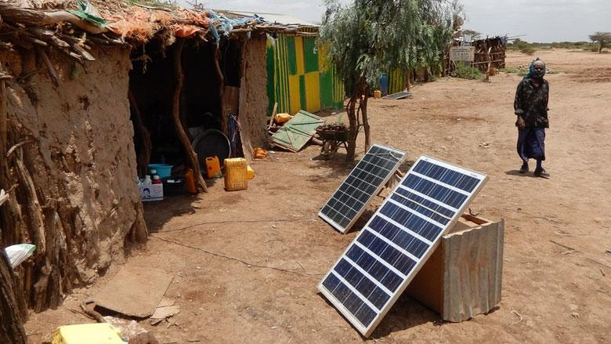
SECTION 08 — CLOSING
Where We Are in the Design Journey
Confirmed
In Progress
Field Survey Will Resolve
Solar & wind resource (39-46yr datasets)
Community questionnaire deployment
Actual load inventory
Demographic anchor loads
Spiro/Roam partnership scoping
Land availability & tenure
Reference system architecture (Mweiga)
Site visit planning
Borehole & water data
Climate constraints (dust, heat, derating)
Third-life battery supply chain mapping
Seasonal RH for AWG sizing
WEFE nexus framework
WTP, tariff, mobile money
Third-life battery concept & partners
Local reconditioning capacity
Key Insight
Next Milestone
Mweiga proved the methodology. The Merti questionnaire will unlock the design. Third-life batteries via local partners will make it affordable and circular.
Field data collection followed by load demand design based on questionnaire responses. This will enable accurate system sizing and economic modeling.
Next Steps: Load Demand Design Based on Questionnaire Responses

